Slide 1
Quantization
An Introduction

Slide 2
Table of Contents
1
What is Quantization
6
Post Training Dynamic Quantization
2
Float 32 in Memory
7
Post Training Static Quantization
3
Symmetric Quantization
8
Quantization Aware Training
4
Asymmetric Quantization
9
ONNX Model Quantization
5
Modes of Quantization
10
Bits and Bytes for Quantization

Slide 3
What is Quantization
Edge devices like cell phones, microcontrollers, have less memory in MBs
When we want to deploy ML models in these devices, we require to optimise them such that they can run on these devices.
An option for Optimisation is Quantization.
Reduces memory footprint by reducing model size.
Inference becomes faster.
Both PyTorch and TensorFlow support quantization, more details in next section.
There are some tools which can quantize ONXX models and API like NVIDIA TensorRT which might ease this quantization process.

Slide 4
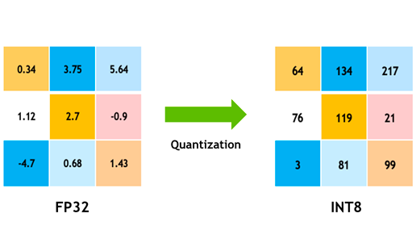
What is Quantization
Quantization is the process of reducing the model size and do fast computation by converting the model parameter from float32 to int8 or lower bits representation.
Float32 To INT8:
4x reduction in size
2-4x reduction in memory bandwidth
2-4x faster inference

Slide 5
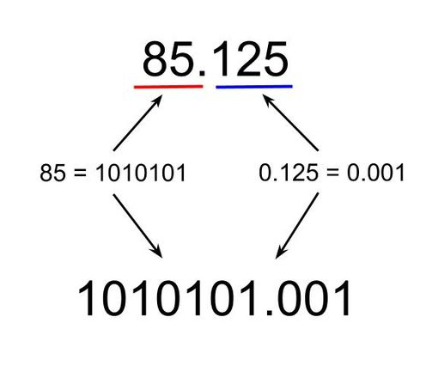
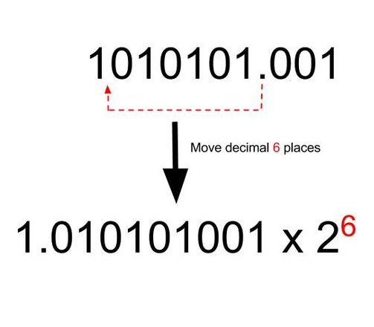
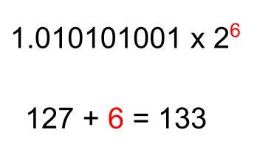
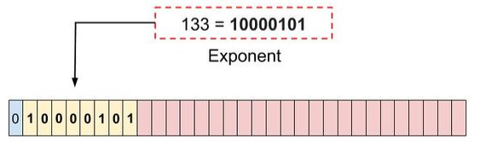
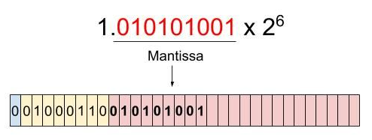
Float 32 representation in memory

Slide 6
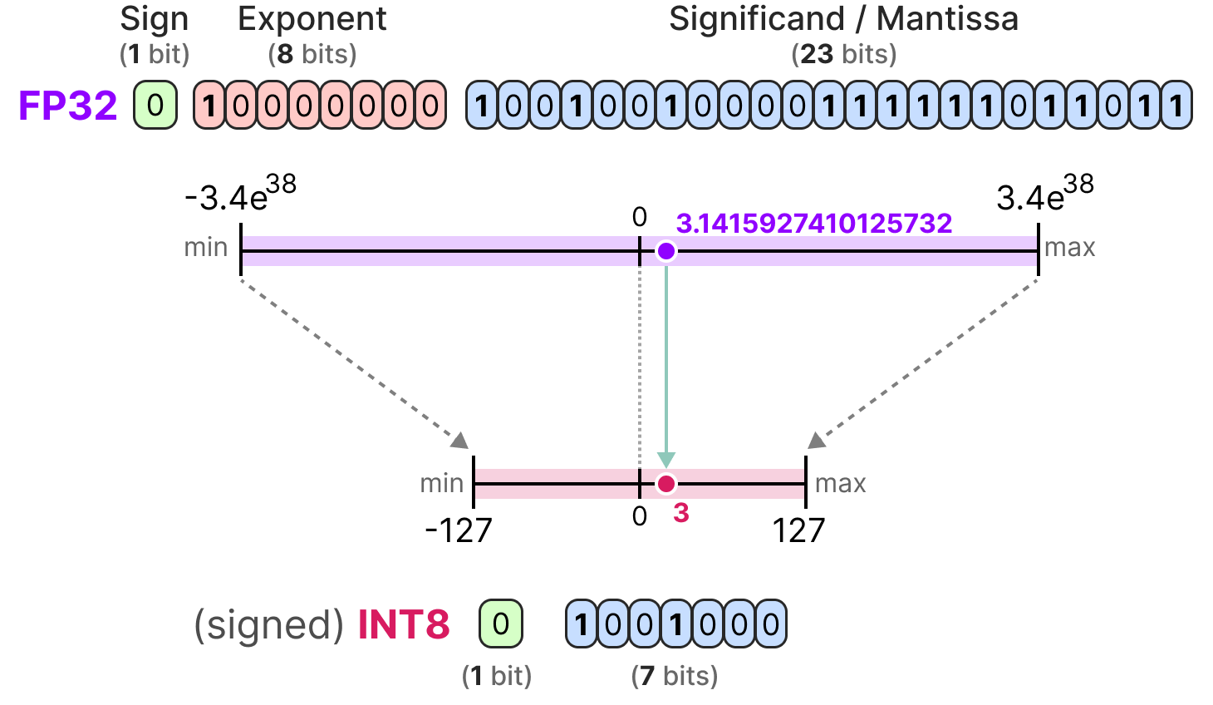
Int 8 representation in Memory

Slide 7
Types of quantization
Symmetric Quantization
Use a zero-centered scale where values are mapped symmetrically around zero
Range : -127 to 127 (for 8 bit)
Good for balance dataset distribution.
Asymmetric Quantization
Different scale and zero point, allowing a shift in the representation.
Range : 0 to 255 (for 8 bit)
Good for unbalanced data distribution.

Slide 8
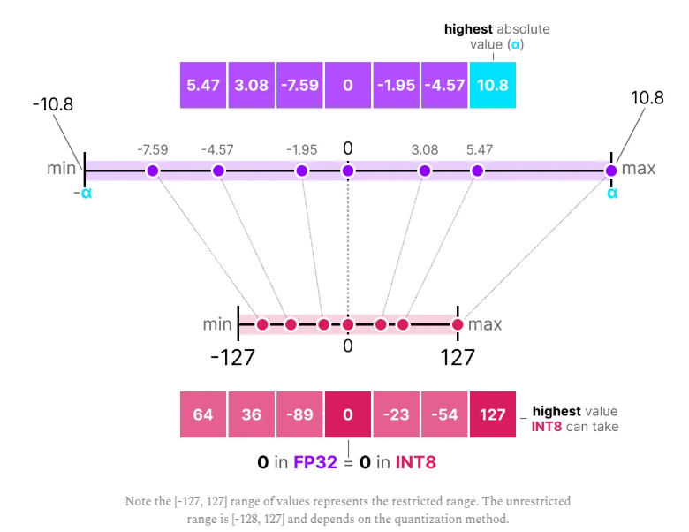
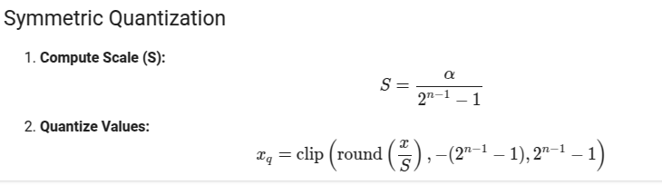
What is Symmetric Quantization
- alpha (max value): The absolute maximum value of the input data.
- S (scale): The factor that maps floating-point values to integer values.
- Z (zero-point): The offset applied to align the quantized values.
The process of choosing these clipping values alpha and beta and hence the clipping range is called calibration.

Slide 9
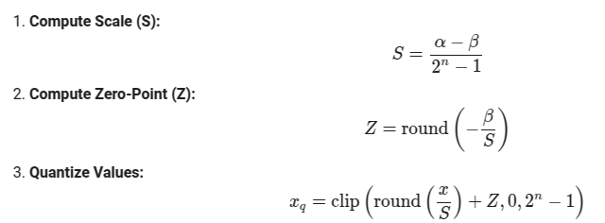
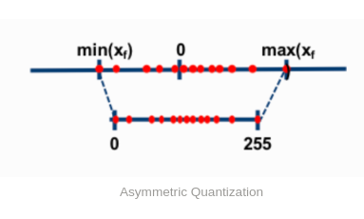
What is Asymmetric Quantization
- alpha (max value): The maximum value of the input data.
- beta (min value): The minimum value of the input data.
- S (scale): The factor that maps floating-point values to integer values.
- Z (zero-point): The offset applied to align the quantized values.
- n is 8 in case of int8 conversion.

Slide 10
3 Modes of Quantization
01
Weights are quantized ahead of inference, but activations are quantized dynamically during execution.
Suitable for models with lots of matrix multiplications.
Post Training Dynamic Quantization
02
Both weight and activations are quantized before inference.
Require a representative dataset for calibration.
Less accuracy but faster as compared to dynamic quantization.
Post Training Static Quantization
03
The model is trained with quantization in mind.
Simulated the effects of quantization during training to reduce accuracy loss.
Provides the highest accuracy among the three methods.
Quantization Aware Training

Slide 11
Dynamic Quantization
‹#›
What is Dynamic Quantization?
- We select layers to quantize (like Linear layers)
- Not all layers are compatible for dynamic quantization. (check pytorch docs)
- The weights of these layers are quantized to int8 before inference
- The model continues to take float32 inputs
Input Handling
- When float32 input hits a quantized layer
- The input is temporarily quantized to int8 just for the matrix multiplication
- This is done because int8 × int8 is much faster than float32 × float32 on CPU
- This temporary quantization uses dynamic scaling factors calculated on-the-fly

Slide 12
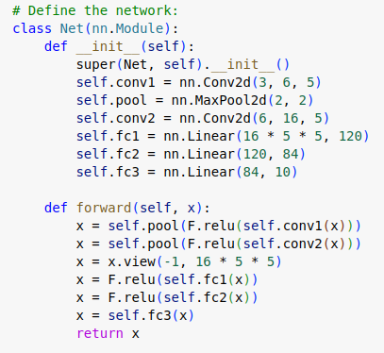
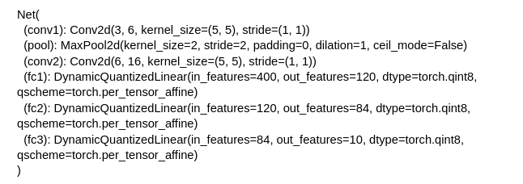
Dynamic Quantization - PyTorch
Quantization API
quantized_model = torch.quantization.quantize_dynamic(
model, {torch.nn.Linear}, dtype=torch.qint8
)
Quantized Network

Slide 13
Static Quantization
Unlike dynamic quantization, static quantization does not calculate the zero point (z) and scale factor (s) during inference but beforehand.
To find those values, a calibration dataset is used and given to the model to collect these potential distributions.
Once we calculate s and z, we perform quantization to the model.
Same s and z values are kept for every batch which can lead to model become less accurate as compare do dynamic quantization.
Static quantization is less accuracy but faster than dynamic as it don’t need to calculate s and z per every layer.

Slide 14
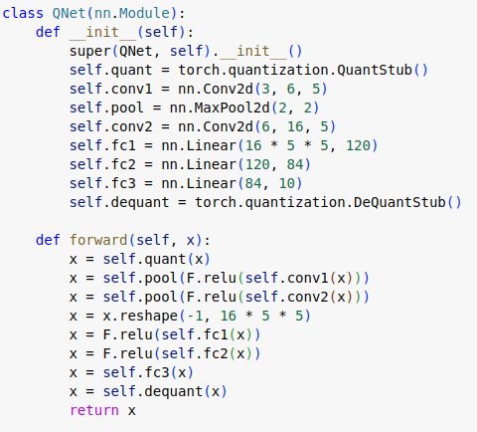
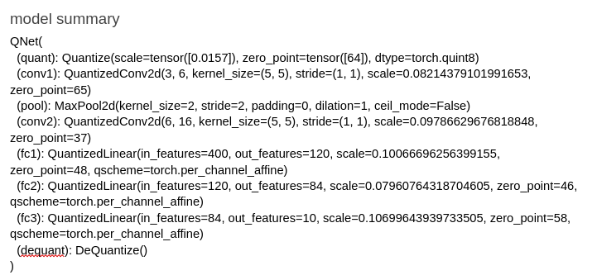
Static Quantization
Quantization API
# Static quantization pytorch needs to happen on CPU
qmodel = QNet().to('cpu')
qmodel.load_state_dict(model.state_dict())
qmodel.eval()
# Set qconfig for static quantization
qmodel.qconfig = torch.ao.quantization.get_default_qconfig('fbgemm')
# Prepare model for quantization (adds observers)
qmodel = torch.ao.quantization.prepare(qmodel)
# Calibrate the model
calibrate(qmodel, train_loader_subset)
# Convert to quantized model
qmodel = torch.ao.quantization.convert(qmodel)
Quantized Network

Slide 15
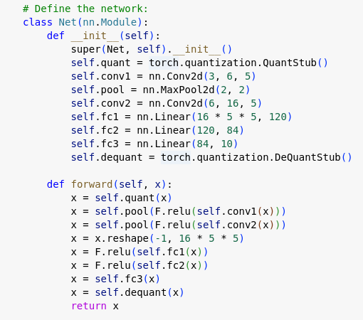
Quantization Aware Training
Quantization API
# before train
model = Net().to(device)
model.train()
model.qconfig = torch.ao.quantization.default_qconfig
model = torch.ao.quantization.prepare_qat(model)
# After Training
model.eval()
q_model = torch.ao.quantization.convert(model)

Slide 16
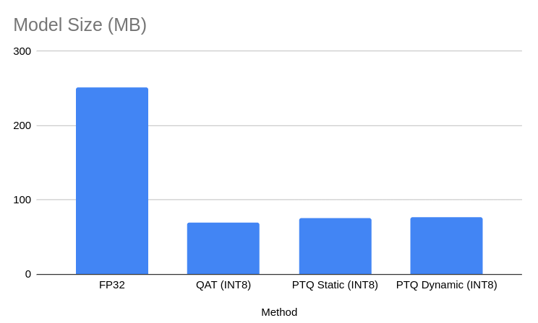
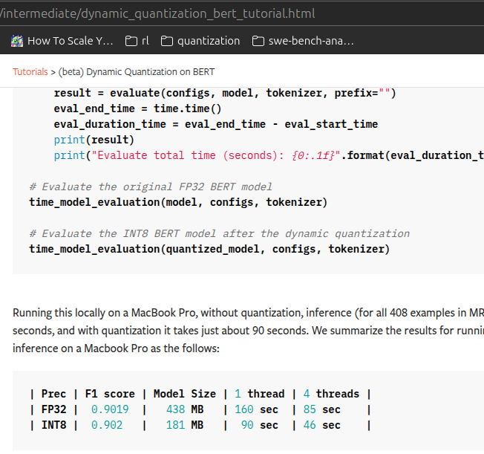
Results
Model Name | Method | Accuracy | Model Size (MB)
FP32(Original) | Non Quantized Model | 0.4731 | 251.618
QAT (INT8) | Quantization Aware Training | 0.486 | 69.922
PTQ Static (INT8) | Post Training Static Quantization | 0.4719 | 76.002
PTQ Dynamic (INT8) | Post Training Dynamic Quantization | 0.4719 | 76.634

Slide 17
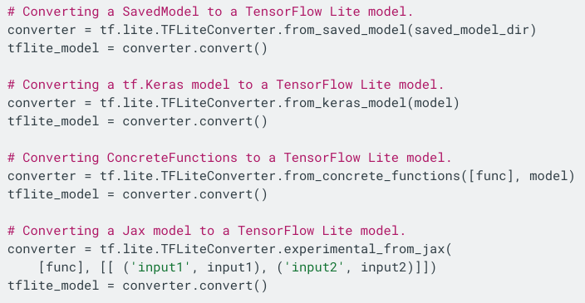
TFLiTe Framework
TFLite is an open source tensorflow framework format for on device inference.
TFLite converter converts the tf model to tflite model which is efficient in terms of memory footprint and accuracy.
Designed for edges devices deployment.
Cross-platform support like android, ios, et. cetera is available.
Post quantization, the model is stored as tflite model which saves the memory footprint even more.
More details please check - https://www.tensorflow.org/api_docs/python/tf/lite

Slide 18


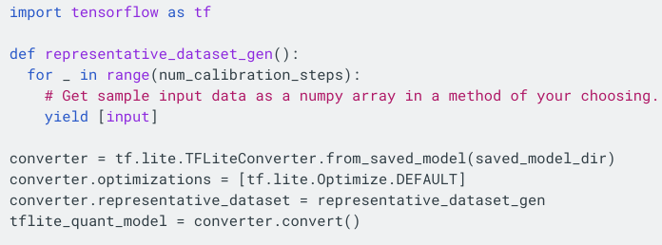
Post Training Quantization - TensorFlow
Dynamic range quantization
The weights and bias of model are stored in INT8, while activations are still expected to be FP32.
During inference, the activations, model inputs are converted to INT8 and back to FP32 after operation completion.
Little slower as there is a computation overhead, but more accurate than Full integer quantization
FP16 Quantization
Full integer quantization
The activations, inputs are also quantized to INT 8.
So we require some representative dataset to run few inference cycles like 100-200 samples.
References
Notebook
Notes:
References
Notebook

Slide 19
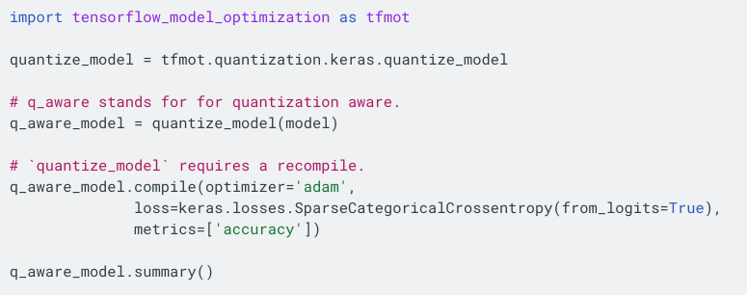
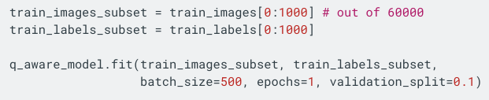
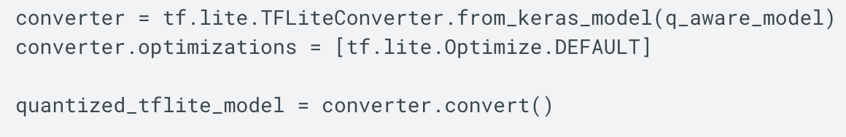
Quantization aware training - TensorFlow
Non-quantized model is trained first.
Then this model is converted to quantized model using tfmot library.
Still the model is not actually quantised, just made aware of quantization.
This quantised model is compiled, trained for a epoch. This is when actual quantization happens and then the model is saved in tflite format.
References
Quantization aware training comprehensive guide
Notebook

Slide 20
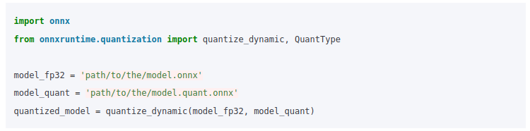
Quantize ONNX models
Dynamic quantization
References
Quantize ONNX models | onnxruntime
Static Quantization

Slide 21
Bits and Bytes for Quantization
Efficient 8-bit and 4-bit quantization of the models.
Enables training large models on smaller GPUs.
Commonly used with QLoRA to finetune quantized models.
from transformers import AutoModelForCausalLM, BitsAndBytesConfig
quantization_config = BitsAndBytesConfig(load_in_8bit=True) # (load_in_4bit=True)
model_8bit = AutoModelForCausalLM.from_pretrained(
"openai-community/gpt2",
quantization_config=quantization_config
)

Slide 22
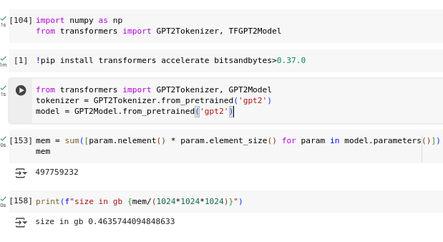
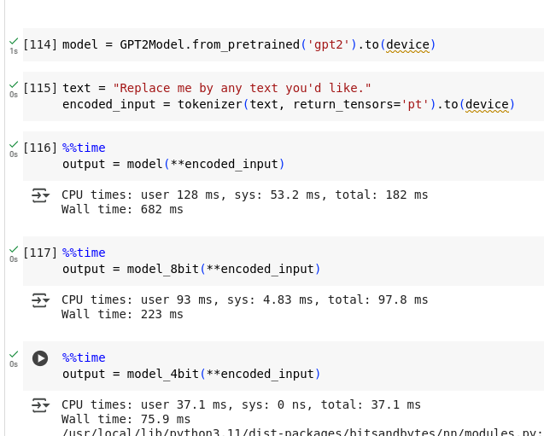
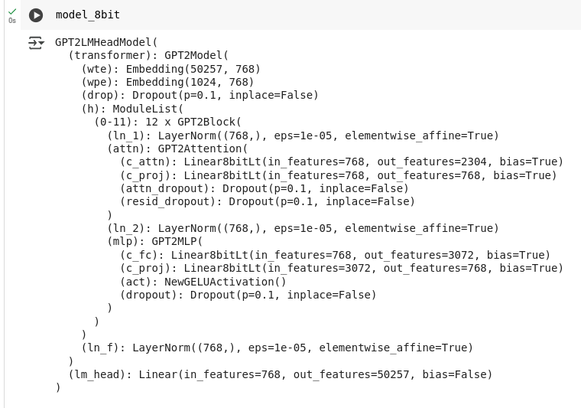
Bits and Bytes for Quantization

Slide 23
Questions?
‹#›
Quantization Notes: https://docs.google.com/document/d/1nnLzntcTBpXve6U2KyRd_3sCcWltehQ6AkUrEBXGUeA/edit?tab=t.0#heading=h.akai19ltkxpg

